Slide 1


About the Webinar
Boards have long faced information overload and limits on decision-making capacity
Today, AI is a force reshaping how boards operate
Drawing on recent research into how directors are already using AI in practice, this webinar will:
              - Explore how AI is transforming board effectiveness
    - What it means for directors
    - How governance professionals can support the change
1

Slide 2
What can you expect to learn today?
Why AI is the driving force reshaping board effectiveness
Recognise how AI changes the way directors prepare and make decisions
See how board reports and the board pack evolves into a semantic knowledge base
Identify the new support role for governance professionals and back office
Gain practical steps to begin integrating AI into boardroom practice safely
2

Slide 3



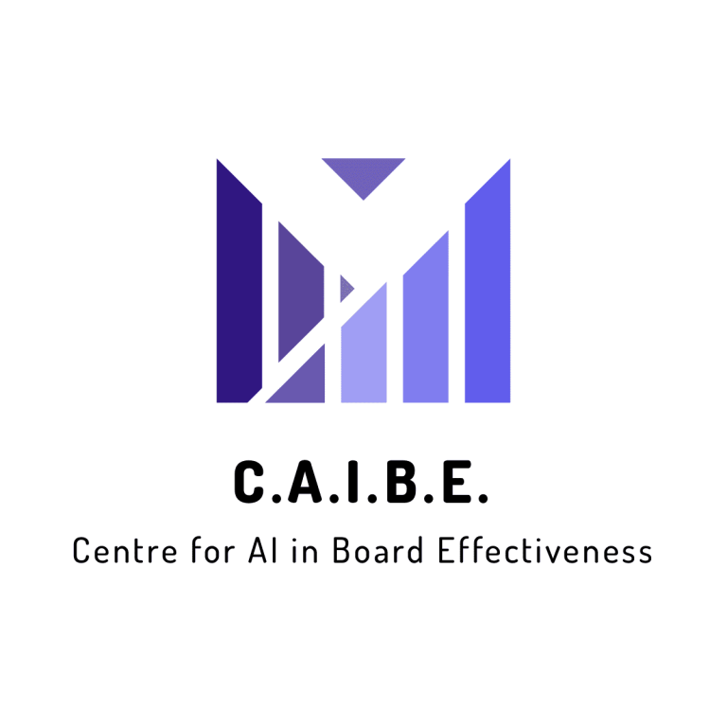

About the speaker:
Paul Stark
3

Slide 4

The Default State
Board Packs are too long:
      Regulation and compliance pressures
      Risk aversion and liability protection
      Increasing complexity of business
      The limits of director processing power:
      Not enough time to digest
      Missing or shallow insights for decision-making
4

Slide 5
The Impact on Board Effectiveness
Director surveys consistently report board papers are too long, contain too much operational detail and too little decision-supporting insights.
IoD
NACD
ICAEW
Board Intelligence
FT Director Programme
Board effectiveness surveys report the same for the c-suite rating their board and directors rating each other
PWC
The Conference Board
NACD
Board Intelligence
McKinsey
5

Slide 6

Why is AI a Driving Force?
A boardroom tool that:
      Improves directors’ processing capacity
      Converts static reports into a dynamic universe of information
      In a searchable form with conversational access
      Amplifies the ability, not automating the work
6

Slide 7
What the CAIBE Research Shows
Driven by personal experimentation by directors in consumer AI.
Uploading board information to:
Summarise long papers
Extract information
Brainstorm questions
Explore unfamiliar topics
Scenario testing
Outside of organisational control and alignment.
Directors are leading the experimentation
Not in purpose-built and controlled systems
Misalignment when it is
Inconsistent board practices
Lack of governance control
7

Slide 8
Similar Patterns in Other Research
  Institute of Directors (IoD) (UK, March 2025)
  Corporate Board Member / Diligent Institute & FTI Consulting (US, late 2024)
  GC100 (UK, Nov 2024)
  National Association of Corporate Directors (NACD) (US, July 2025)
  Diligent Institute (Global, 2024)
  Board Agenda & INSEAD (Global)
  BoardCloud (Global, July 2025)
  Board Intelligence (UK, 2023)
  Directors & Boards (US, Aug 2025)
8

Slide 9
The New Boardroom Environment
It’s not just about AI
Don’t forget data, people and change management
9

Slide 10
Data & Technology
Supporting the human and machine reader
Decision-intelligence structure
Framing layer
Reference layer
Boardroom semantic knowledge base
LLM
Conversational AI
Memory
Governance controls
Smart Assistant
10

Slide 11
People & Team Changes
For Directors:
Shift in engagement
Skills development
Mindset adjustment
Consistency
For Board Support Teams:
New responsibilities
Training & fluency
Cultural role
Ongoing support
11

Slide 12
Board Support Redefined
New Definitions:
AI enablers of board effectiveness
Structuring information for human and machine readers
Guardrails
Facilitators
A bridge
Key Responsibilities:
Data & Knowledge Management
Governance & Assurance
Enablement & Training
Continuous Support
Technology Upgrade
12

Slide 13
Phased Rollout Approach
Why it Matters:
Risk and trust
Phasing allows control
Adding capability and assurance
Parallel growth
Safe environment
High-Level Example:
Start small
Add structure
Introduce system parts
Embed practice
Evolve and improve
13

Slide 14
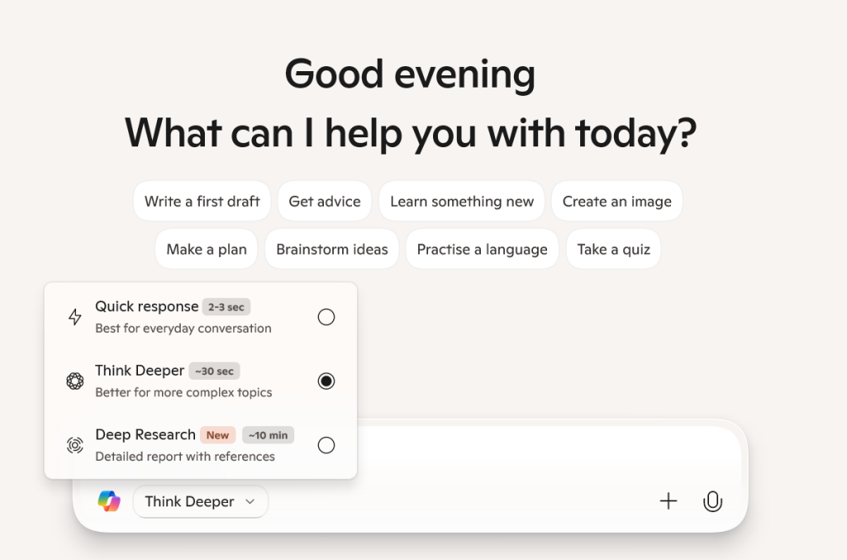
Example: Knowledge Base
14

Slide 15
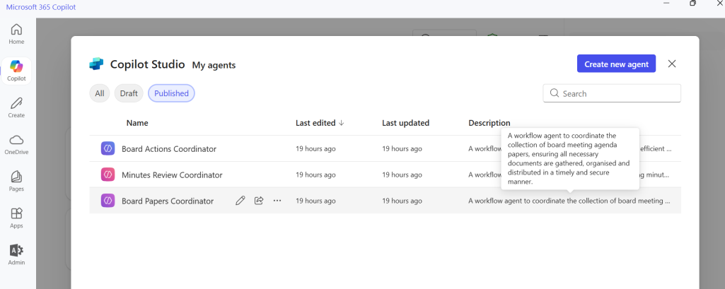
Example: Boardroom Agents
15

Slide 16
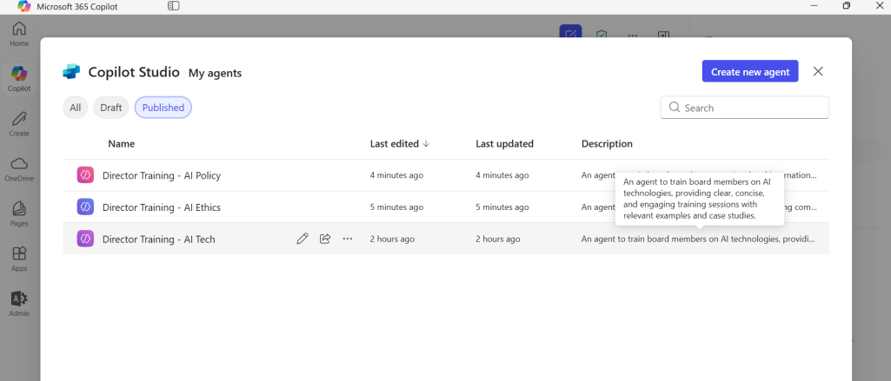
Example: Education & Training
16

Slide 17
Practical Steps
Acknowledge the reality
      Start with data readiness
      Pilot low-risk use cases
      Set guardrails early
      Invest in fluency
      Phase adoption
17

Slide 18


Questions?
18

Slide 19
Masterclass
Thank you

