Slide 1


Welcome to the Masterclass
The Crucial Role of the Company Secretary
Gerry Egan, M.Sc (Mgmt.), C. Dir
Governance Consultant and Trainer
8th October 2025
Insight + Impact

Slide 2
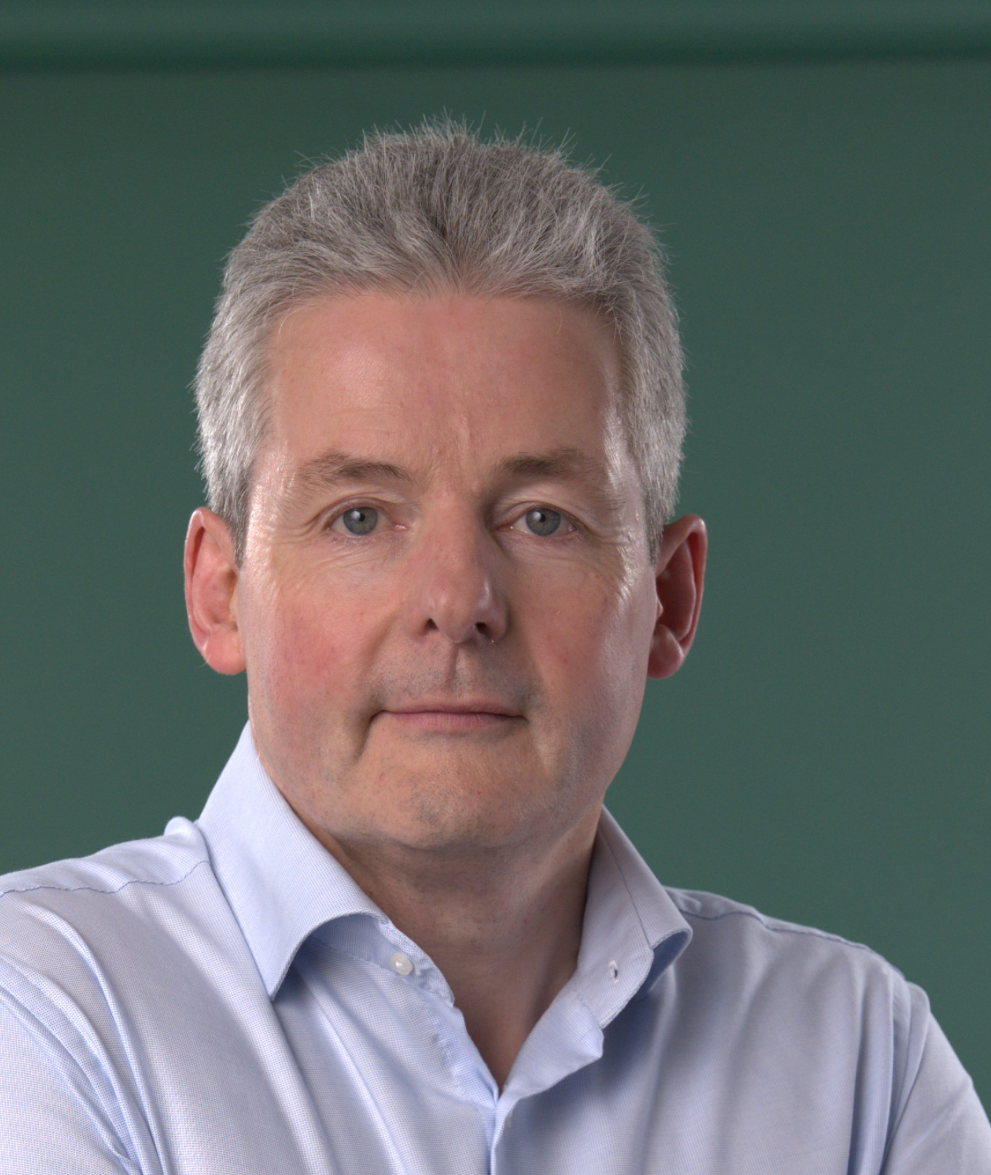

About the speaker
Gerry is an experienced Chair, Director and Company Secretary with over 30 years in the front line of corporate governance as an executive and Co. Sec., then as a Director and Chair and latterly as a consultant and trainer.
These various perspectives have provided him with insights into how the Co. Sec can be most effective in setting the board up for success which he will share with us today.
Gerry Egan
2

Slide 3
What can you expect to learn today?
1. Mastering the basics
2. Setting the board up for success
3. So, you want to be a trusted adviser..
4. Managing your own development
3

Slide 4


A privileged position
Present when the important decisions are taken
Privy to confidential and sensitive matters
A trusted adviser to the Board and Executive
Opportunity to build one’s personal influence
Significant career opportunity
Essential to earn trust and confidence – someone who can be relied on
4

Slide 5
Understanding the basics
Ensure compliance with company law obligations
Comply with all reporting and filing requirements
Maintenance of company registers e.g. shareholders, directors
Arrange statutory meetings e.g. AGM or EGMs
Working knowledge of company law, contract law, relevant governance codes, charity law, the company’s foundational documents and company secretarial practice
Support the board/directors in the performance of their duties
Interface between Board and Executive
An ‘officer of the company’ – their success is your success
Good organisational and planning skills
‘Concern for order’ – the small details matter
Understand the board dynamics and adapt to the situation
Expansion of role into other areas….Chief Governance Officer ….
5
Notes:
Requirements vary significantly depending on the company.
Assume at least medium size company with a properly constituted board that meets regularly and therefore needs consistent support.
Does she need to be a lawyer?
Board may be made up of executives, non – execs, mixture of both, all volunteers in the case of charities.
Requirements will vary
Oil in the machine keeps it running smoothly
Service mentality - not servile - top restaurants service is professional, courteous, friendly, big component of experience ….
Board dynamics – reading the room and the situation.

Slide 6
What can you expect to learn today?
2. Setting the board up for success
6

Slide 7

Setting the board up for success
Planning the work of the Board and Committees – the annual workplan
Planning Board meetings in conjunction with Chair and CEO
Creating effective agendas ensuring that strategy development and implementation is front and centre
Preparing Board packs and assuring the quality of board papers to enable the board to make quality decisions
Observing and minute taking - learning to observe and listen actively, and record accurately
7

Slide 8
Annual workplan for board and committees
A plan to:
Enable board to achieve its objectives for the year
Fulfil statutory obligations
Meet internal governance requirements
Create a master calendar of board and committee meetings
Schedule set piece and recurring events e.g. board away day, mid year strategy review, engagement with auditors, annual safety review
Provides clarity for directors, committees and executive
8

Slide 9
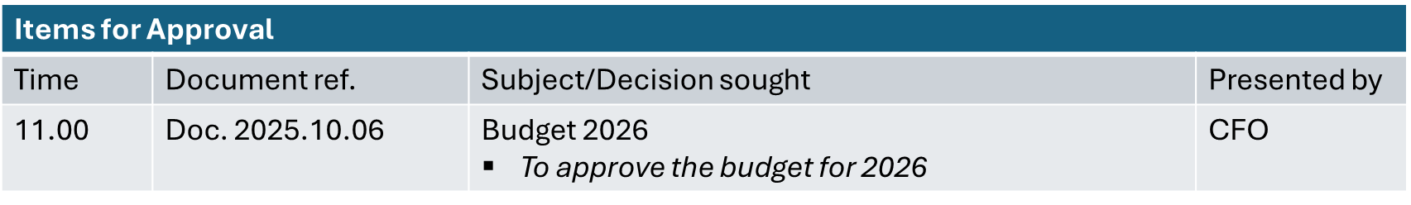
Creating effective agenda
Develop in partnership with Chair and CEO to reflect their priorities
Most important/decision items first (time and energy)
Clear ‘ask’ – what is this agenda item for? (decision, consideration, information)
Items for Information
Time | Document ref. | Subject/Consideration Sought | Presented by
12.30 | Doc. 2025.10.09 | New EU Regulation on AI To note the new regulation and management’s initial assessment of the impact | CIO
Take a break
Allocate private board time at every meeting
9

Slide 10
Provide quality board packs
Papers for board meetings emanate from different departments
Co. Sec has key role in ensuring the pack is cohesive:
Use standard templates based on brand guidelines – present united front
Organise papers to follow order of agenda
Understand the audience and provide appropriate level of detail
Summary of topic and outcome sought (next slide)
Be clear about the ask:
Decision, provide input into new policy, information about important development
Issue 5-7 days before meeting
Working assumption: all papers read in advance – no repeat presentations
10

Slide 11
What is this paper for?
Board Meeting – 30 April 2025
agenda Item # | 2025.04..07
Subject | Proposed Investment in New Warehouse
Board Consideration | Decision ☒ | Consideration (future decision) ☐ | Noting ☐
PRESENTED BY | John Smith
SUMMARY
Summary: Serious difficulties have been encountered in serving customers in the North East in the past 12 months because of traffic congestion Customer satisfaction has suffered significantly as a result Management believes that the best solution is to construct a new warehouse off the M1. The project is expected to generate a return on investment of 12%; would have a payback period of four years and can be funded from our own resources Decision Sought: Approve an investment of €3m in a new warehouse to be funded from our own resources
11

Slide 12
Recording the outcome – taking minutes
Essential legal record of the meeting.
record decisions and provide the context
reminder of actions agreed
inform those who were not at the meeting and
Crucially, demonstrate that directors are performing their legal duties
Record of:
When and where the meeting took place
Who attended – distinguishing between Board members (present) and others (in attendance) – and who chaired the meeting
Any conflicts of interest declared
Matters considered by the meeting and the outcome in relation to each matter i.e. decisions taken and actions arising, other inputs e.g. advice or recommendations by the board and matters noted by the board.
Dissenting views on any matter decided by the board should also be recorded along with the name(s) of the dissenting directors.
Primary purpose is to record precisely decisions taken by the board.
Important to capture the context and colour of the discussion – but not a verbatim record of everything discussed.
Not necessary nor appropriate to record the names of each contributor although sometimes a director may wish to have their contribution noted e.g. if they are dissenting from a majority decision.
In some regulated industries e.g. financial services, it may be necessary to record additional contributor details to demonstrate that directors are challenging adequately.
Style of minute taking e.g. degree of formality may also be informed by cultural norms in different countries.
12

Slide 13
Additional supporting roles
Induction of new directors
Understanding of legal duties and responsibilities and how these differ from being an executive or manager
Briefing about the business
Providing informal support for directors
Evaluation of board performance
Succession planning and skills audits
13

Slide 14
What can you expect to learn today?
3. So, you want to be a trusted adviser..
14

Slide 15
1
Earn the right to be trusted
Know your job and do it well
Understand legal and other responsibilities of Company Directors and Secretary
Develop good systems and processes
Sweat the small stuff
“ Don’t try to impress me, just be impressive”
2
3
Respect and represent the directors when they are not around
15

Slide 16
4
Give your honest opinion when asked
5
Be prepared to tell people what they ‘don’t want to hear’
6
Respect confidentiality
7
Have a service mindset
16

Slide 17
What can you expect to learn today?
4. Managing your own development
17

Slide 18
6
2030s: ????
5
2020s: Chief Governance Officer
4
2000’s: Strategic governance adviser
3
1990’s: Legal and Compliance Officer
2
1980’s: Administrative custodian
1
Way back when: ‘A mere servant’
18

Slide 19

Shaping the job
The Co. Sec role has huge scope for personal growth and development
Roles in companies are often what we make them and how we choose to perform them
If we behave like an ‘administrative assistant’ or like the Chief Governance Officer that is how we will be perceived
19

Slide 20
Progressing in the role
Ongoing CPD
Changes in company law
Updates to corporate governance codes (e.g. UK Corporate Governance Code)
Sector-specific developments (e.g. NHF Code for Housing, Code of Governance for State Bodies)
Boardroom dynamics and governance trends (e.g. ESG, stakeholder engagement, AI and digital governance)
Practical experience
Early career
Attending meetings, taking minutes
Managing registers and filings
Learning entity management software
Mid career
Advising board on governance and regulatory matters
Supporting board evaluations and skills audits
Senior level progression
Confidant to chair
Leading initiatives e.g. ESG across group structures
Liaising with regulators
Exposure to strategic and governance challenges
Projects
Policy development and roll out
Support for acquired companies
Negotiation of significant contracts
Take the initiative!
20
Formal knowledge and qualifications
Legal and governance, accounting, risk and compliance

Slide 21
Recap
1. Mastering the basics
2. Setting the board up for success
3. So, you want to be a trusted adviser..
4. Managing your own development
21

Slide 22


Questions?
22

Slide 23
Masterclass
Thank you

