Slide 1
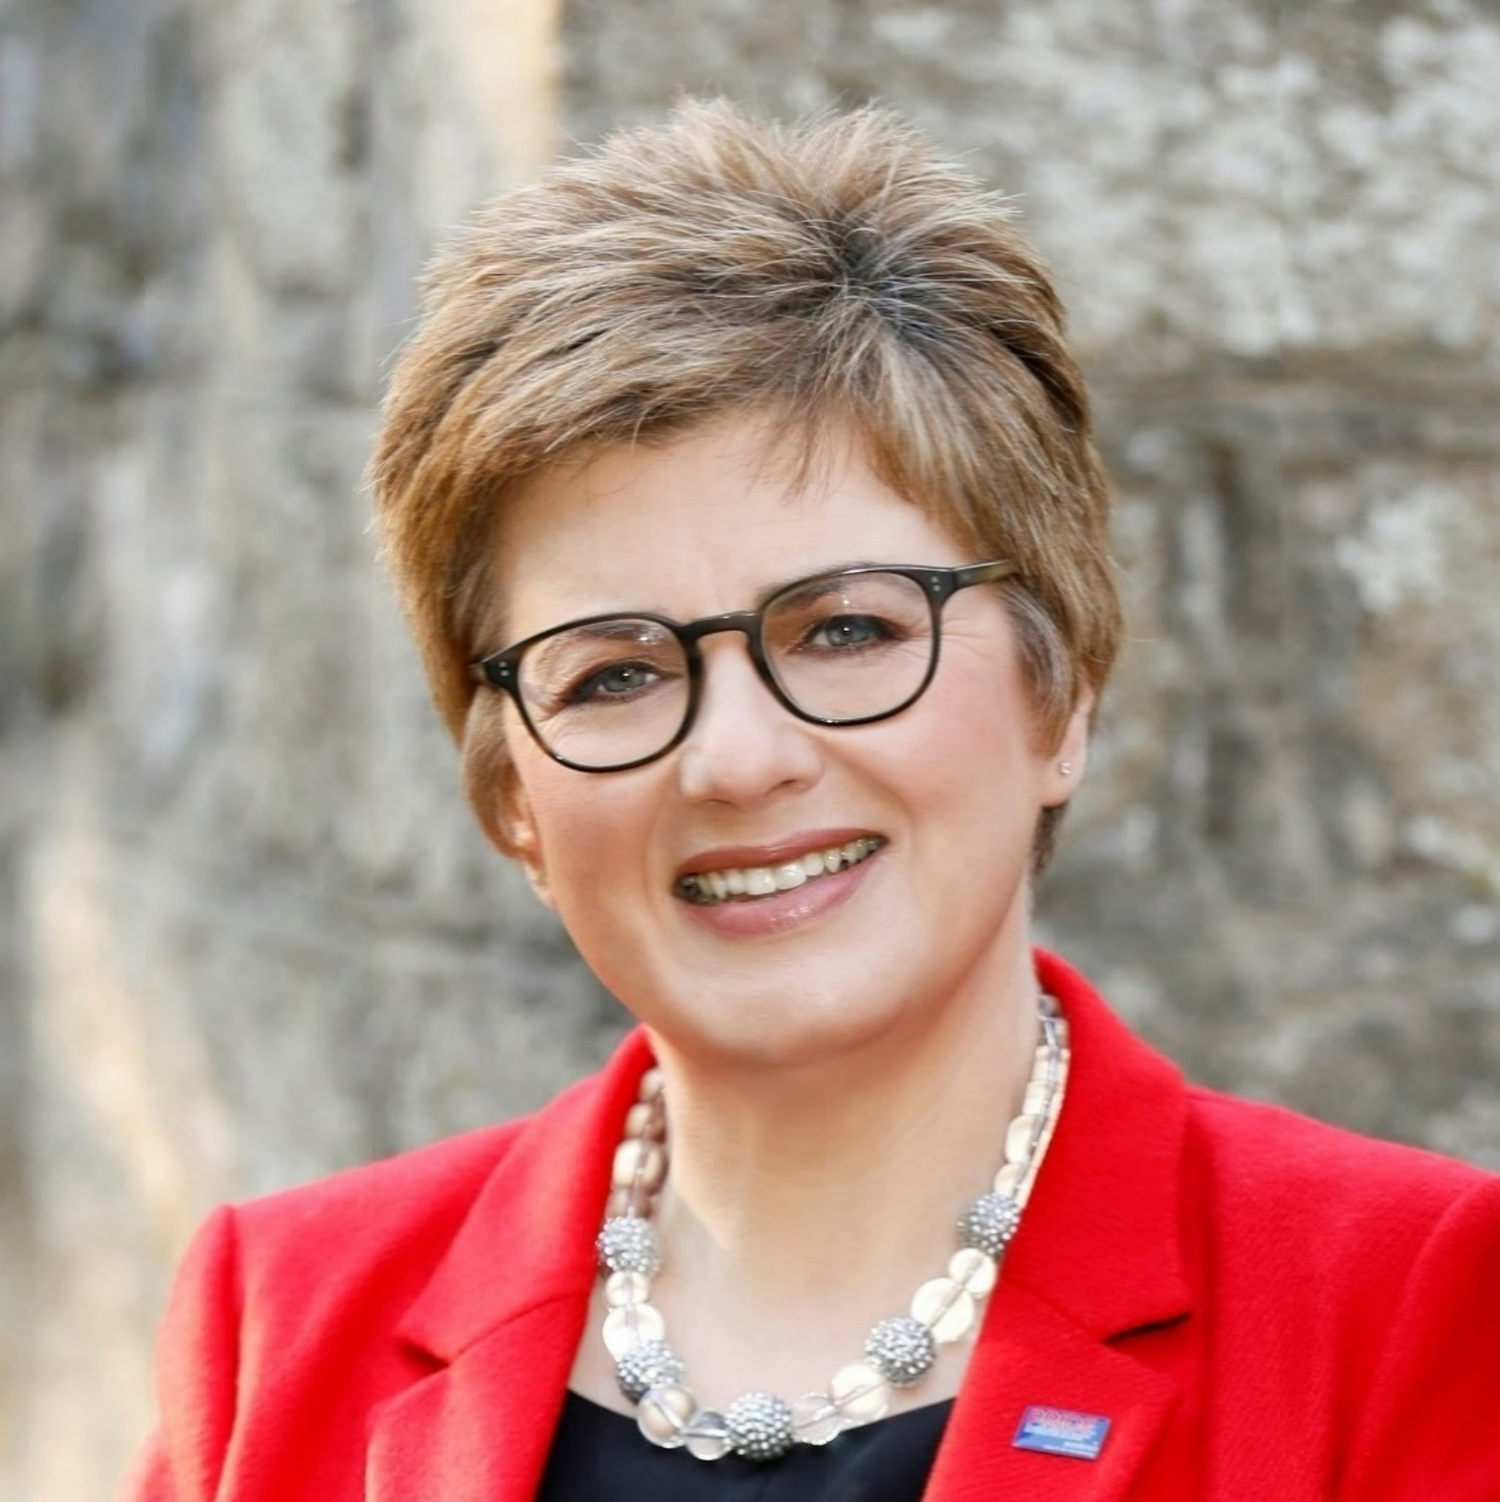
Stop talking, take action on diversity, equity and inclusion
Margot Slattery
Global Head of Diversity, Inclusion and Belonging at ISS
Webinar

Slide 2
What is DEI?
Why is it important?
‹#›
‹#›

Slide 3
DIB initiatives aim to create a more diverse, equitable, and inclusive workplace.
Organisations recognize the benefits of DIB/DIE, including improved innovation, increased employee satisfaction, and better financial performance.
Corporate governance plays a key role in driving DIB/DIE initiatives through diversity and inclusion goals and accountability measures.
Regulatory and societal pressures have also contributed to the rise of DIB initiatives.
DIB initiatives may include recruiting from diverse talent pools, training and education programs, employee resource groups, and diversity metrics tracking.
Diversity, Inclusion & Belonging
‹#›

Slide 4
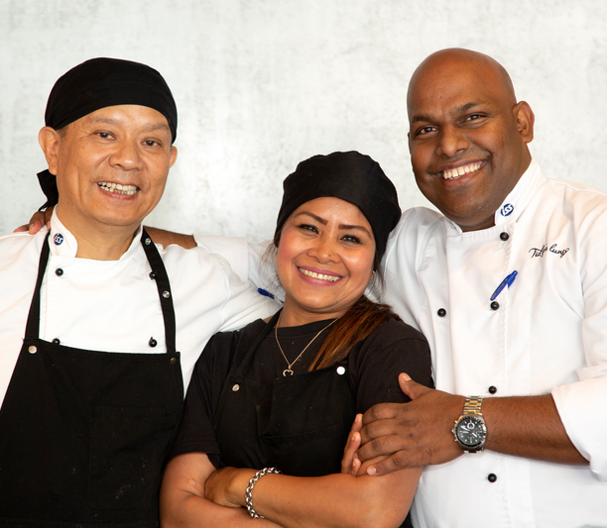
Building a DIB strategy for an organisation
Assess the current state of diversity, inclusion, and belonging in the organization through data collection, surveys, and focus groups.
Define the organization’s DIB goals and objectives based on the assessment results and align them with the organization's overall mission and values.
Develop a DIB action plan that outlines the steps to
achieve the defined goals, such as recruitment and retention strategies, employee training and development programs, and culture change initiatives.
Implement the DIB action plan and establish
metrics and performance indicators to measure progress and success.
‹#›

Slide 5
The importance of communication and socialisation
Communication and socialisation of an organization’s DIB strategy are essential to ensure all employees understand the organisation's commitment to diversity, inclusion, and belonging.
Communication should be ongoing and involve multiple channels, including email, company newsletters, social media, and employee meetings.
Socialisation involves integrating the DIB strategy into all aspects of the organisation, including policies, practices, and decision-making processes.
Employee engagement and feedback mechanisms should be established to foster a two-way communication process.
Effective communication and socialisation of the DIB strategy can help to foster a positive workplace culture that values diversity and inclusion, leading to improved employee morale, retention, and productivity.
‹#›

Slide 6
Setting up a DIB governance at an organisation
Establish a governance structure, define roles and responsibilities
Develop policies and procedures, integrate DIB goals and metrics into the
strategic plan
Create a reporting framework, provide training and education
Foster a culture of diversity, and continuously evaluate and refine the framework.

Slide 7
DIB governance at ISS as an example
Global DIB Committee
Global DIB Team
DIB Council, Europe and UK&I
DIB Council, APAC
DIB Council, Americas
Global DIB Community
ERG – Gender Balance
ERG – Generations & Age
ERG – Cultures, Race & Ethnicity
ERG – Pride
ERG - Abilities

Slide 8
DIB partnerships
Why is it important?
Partnerships can help organisations to leverage expertise, resources, and networks to advance their DIB goals.
Partnerships can also help organisations to learn from others, share best practices, and collaborate on joint initiatives.
How to manage partnerships effectively?
Establish clear goals and objectives, roles and responsibilities, and communication protocols.
Develop a shared vision and values that align with both organisations and establish regular meetings and reporting mechanisms to track progress.
Create opportunities for joint initiatives, such as diversity recruitment fairs, joint training and development programs, and diversity and inclusion events.
Celebrate and promote successes together, and recognize and address challenges and barriers as they arise.

Slide 9
Keep things refreshed
Keep abreast of emerging DIB trends, research, and best practices to identify new opportunities
Engage with external stakeholders, such as customers, suppliers, and industry groups
Establish partnerships with universities, research institutions, and think tanks to access cutting-edge expertise
Promotion of DIB principles enhances respect for human rights, fosters social justice, and contributes to a more stable and equitable geopolitical landscape
Encourage employees to attend industry conferences and events to stay up-to-date on the latest DIB developments
‹#›

Slide 10
How we understand DIB at ISS
+
=
DIVERSITY
[Facts]
Diversity is about the unique characteristics, life experiences, and perspectives – seen and unseen – that make us who we are as individuals and as groups of people.
INCLUSION
[Choice]
Inclusion is about valuing and respecting differences and seeing those as essential for success. To create an environment, where all people are respected and included.
BELONGING
[Inclusive culture]
Belonging is when employees feel they can bring their authentic selves to work. This is when differences are embraced and valued.
‹#›

Slide 11
Our strategy is driven by five dimensions of diversity
Generations & Age
Cultures, Race & Ethnicity
Pride
Abilities
Gender Balance
There are currently
5 generations in
the workplace. We will
focus on generational inclusion and challenge
age biases and stereotypes.
Covering all imaginable differences among cultures, including ethnicity, language, race, religion, indigenous people, refugees etc.
This dimension is about all expressions of sexual orientation, gender and relationship- and family models along with openness, curiosity and inclusion towards those.
Disabilities can be broken into 8 sub-categories, seen and unseen.
We will create workplaces that are inclusive and accessible towards
all abilities.
We will enable gender balance across our organisation, including
a focus on balanced representation of gender within senior leadership.
‹#›

Slide 12
Main External Partnerships
[
To create a more inclusive workplace for LGBTQ+ employees by implementing policies and practices that are respectful of all employees
By 2025, we aim to achieve at least 40% gender balance at the group leadership level
Ensure accessible workplaces, both physically and digitally
We wish to hire refugees and support the economic inclusion of refugee women by offering workshops, apprenticeships and information sessions
We are providing opportunities for young people through apprenticeships, internships, and entry-level jobs
‹#›

Slide 13
Overview of Internal Partnerships
We collaborate with more than 30 countries across 3 regions to achieve our goals
Our 5 global ERGs are essential partners in our efforts
Our EGM members provide valuable sponsorship and support
We have established a global DIB community to promote the importance of DIB
We share DIB initiatives and activities across the organisation through our SharePoint site
‹#›

Slide 14
Social efforts and activities are valuable and make a significant difference for individuals, businesses, and society as a whole.
Every individual has the potential to contribute to the success of an organisation. Therefore, we should broaden our recruitment and talent development approach to identify and embrace unique competencies.
By leveraging the strength and knowledge of everyone, we can collectively make positive social changes.

Slide 15
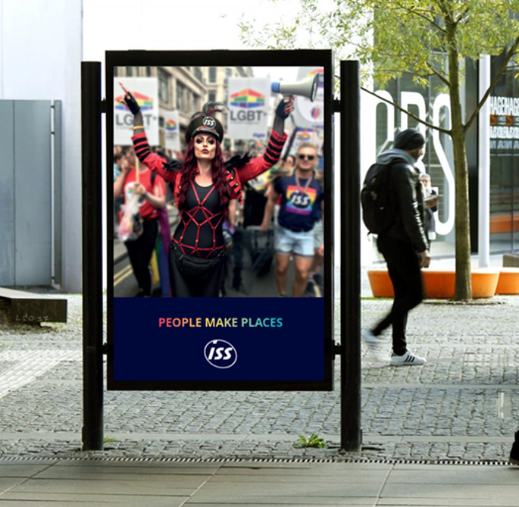

Slide 16
Thank you
info@thecorporategovernanceinstitute.comwww.thecorporategovernanceinstitute.com

