Slide 1
Unleashing
Machine Creativity
Robert Farrell
Digital Transformation Institute
Notes:
If you are worried about the terminator and robots stealing your job then level up your skills by learning to use generative AI to create text, logos, videos, design websites, provide recommendations and even deliver your client presentations… but can it make your coffee?
Understand the concept of generative artificial intelligence (AI).
Explore popular generative AI tools and their use with live demonstrations.
Understand the pros/cons and what organisations need to consider.
Generative Artificial Intelligence (AI) has the power to multiply human creativity but this double edge sword has drawbacks. Explore the pros and cons of Generative AI technology and its impact on various industries.

Slide 2
ccc
Speaker
Corporates, Colleges
Experience
Hubspot, Digital Marketing Institute, Irish Computer Society
Qualifications
Digital Transformation, Digital Marketing, Industry certs
Industry Judge
Spider Awards, Digital Media Awards
Conferences
Digital Transformation, Digital Marketing, Technology
Robert Farrell
cccc

Slide 3
‹#›

Slide 4
Agenda
Learn about Generative AI (GenAI)
Explore popular GenAI tools and their use
Identify some limitations of GenAI
Considers for directors/managers

Slide 5
Introduction to AI

Slide 6
What Comes To Mind When You Think Of AI
Robert Farrell Digital Transformation Institute

Slide 7
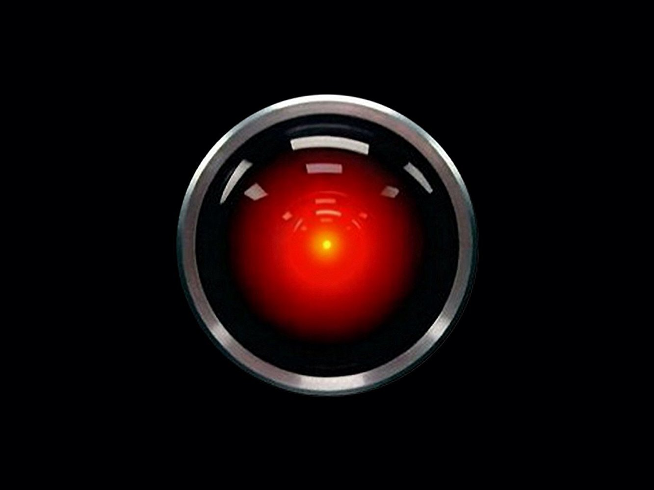
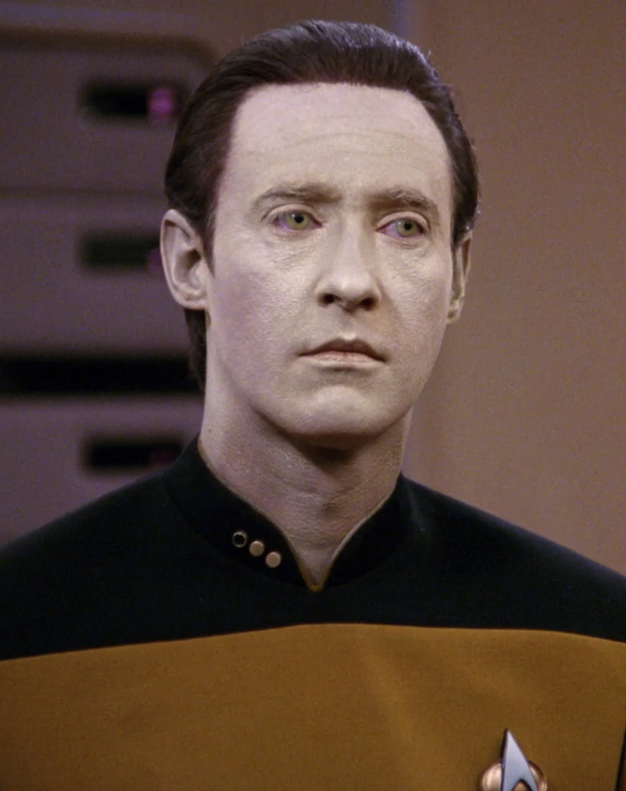
Robert Farrell Digital Transformation Institute

Slide 8
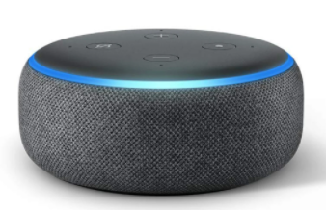
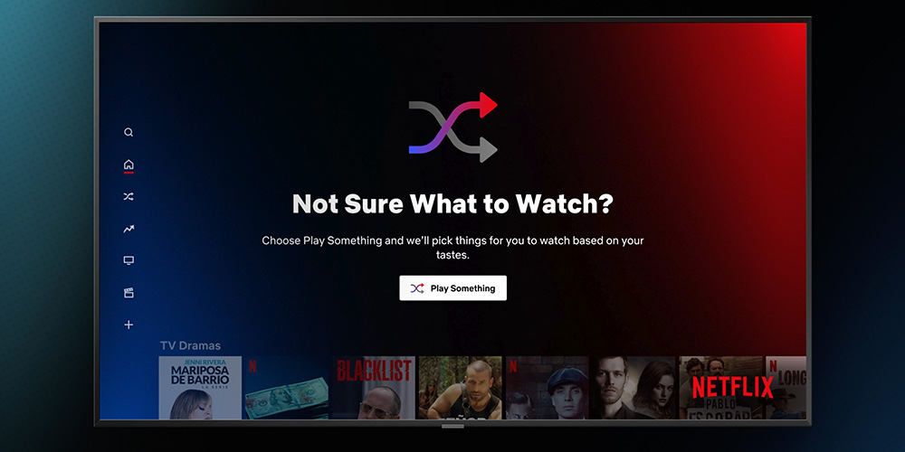
Robert Farrell Digital Transformation Institute

Slide 9
Generative AI
Artificial intelligence that uses algorithms to create new data that is similar to existing data
New digital images, video, audio, text or code.
Robert Farrell Digital Transformation Institute
Notes:
Generative AI refers to a type of artificial intelligence that uses algorithms to create new data that is similar to existing data. This is in contrast to traditional AI models, which only classify or analyze existing data.
Techopedia describe generative AI as broad label that's used to describe any type of artificial intelligence that uses unsupervised learning algorithms to create new digital images, video, audio, text or code. According to McKinsey, generative AI and other foundation models are changing the AI game, taking assistive technology to a new level, reducing application development time, and bringing powerful capabilities to nontechnical users.

Slide 10
The global AI market size was worth $62 billion in 2020, and is expected to have an annual growth rate of 40.2% from 2021 to 2028
(Grand View Research)
40%
Robert Farrell Digital Transformation Institute
Notes:
https://online.wharton.upenn.edu/blog/how-do-businesses-use-artificial-intelligence/

Slide 11
84%
of C-suite executives think leveraging AI will help them achieve their growth objectives (Accenture)
Robert Farrell Digital Transformation Institute
Notes:
https://online.wharton.upenn.edu/blog/how-do-businesses-use-artificial-intelligence/

Slide 12
Robert Farrell Digital Transformation Institute

Slide 13
Text
Robert Farrell

Slide 14
What can ChatGPT do
Generate human-like responses
Answering questions
Summarizing and rewriting text
Translating between languages
Create quizzes and answer questions
Explain complex topics simply
Write, Debug, and Explain Code (mixed results)
Solve math problems (showing steps)
Blog post ideas and outlines
Create emails, essays, meta descriptions
Identify keywords
Create a sales script and rebuttals
Speed of doing work (brainstorming, email etc)
Robert Farrell Digital Transformation Institute
Notes:
https://www.makeuseof.com/things-you-can-do-with-chatgpt/

Slide 15
Demonstration
Robert Farrell Digital Transformation Institute
Notes:
I sell sustainable toothpaste. Provide an overview of my buyer persona.
List 5 blog titles for my website.
Write a 300 word blog about the importance of sustainable products. Include statistics and data.Include a call to action prompting buyers to buy my sustainable toothpaste products
Write a meta description for the blog
Write an instagram post directing audiences to the blog

Slide 16
ChatGPT (Source: Joseph Black via Linkedin)
Robert Farrell Digital Transformation Institute

Slide 17
ChatGPT (Source: Joseph Black via Linkedin)
Robert Farrell Digital Transformation Institute

Slide 18
ChatGPT (Source: Joseph Black via Linkedin)
Robert Farrell Digital Transformation Institute

Slide 19
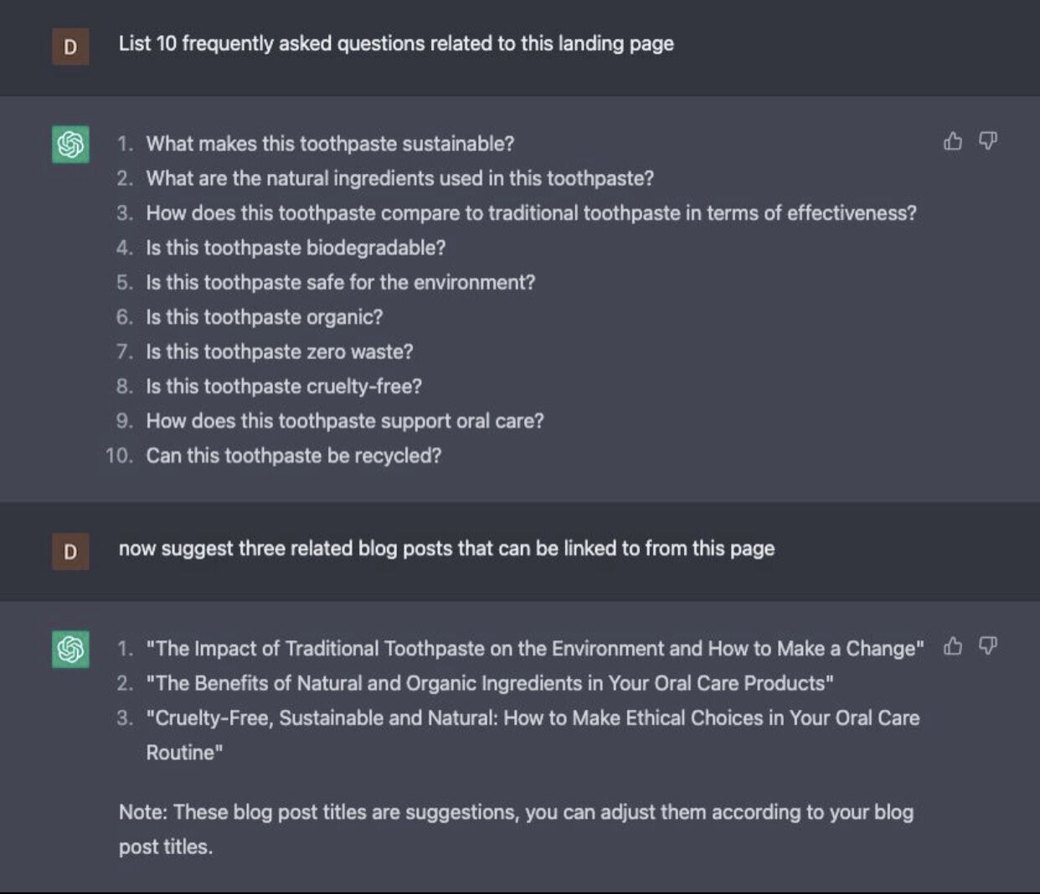
ChatGPT
(Source: Joseph Black via Linkedin)
Robert Farrell Digital Transformation Institute

Slide 20
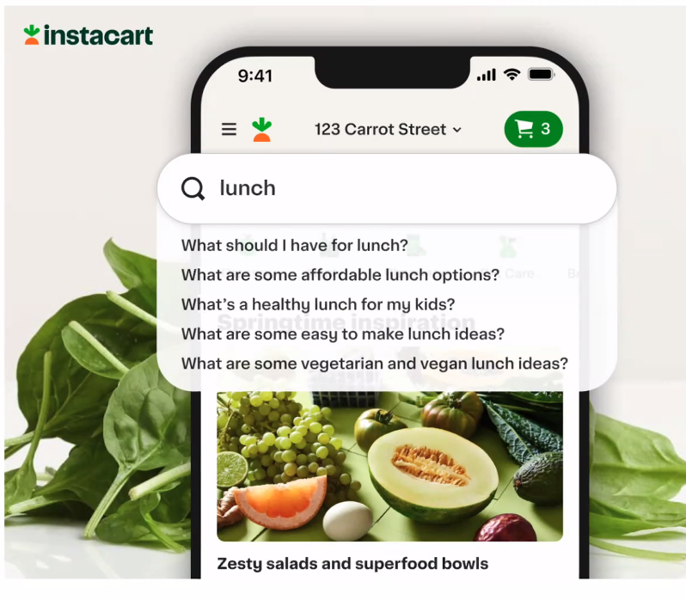
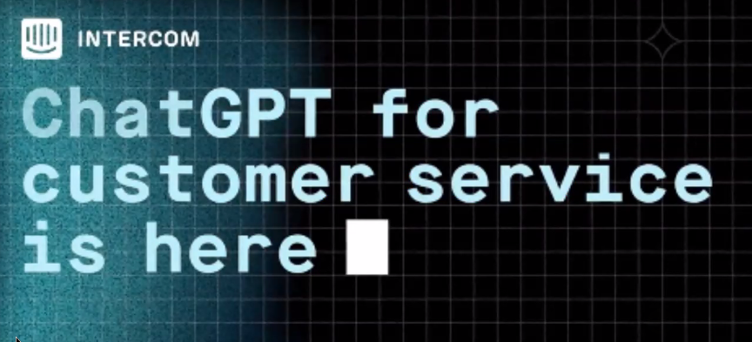
ChatGPT in other apps
Robert Farrell Digital Transformation Institute
Notes:
ChatGPT being incorporated to other apps
Intercom: ChatGPT can route or resolve queries

Slide 21
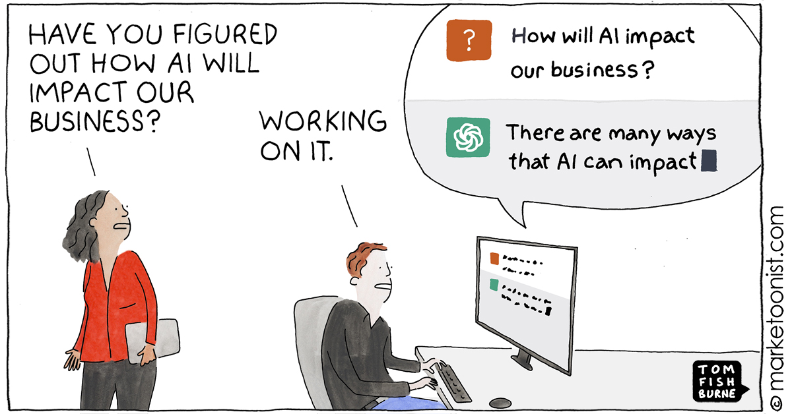
ccc
cccc

Slide 22
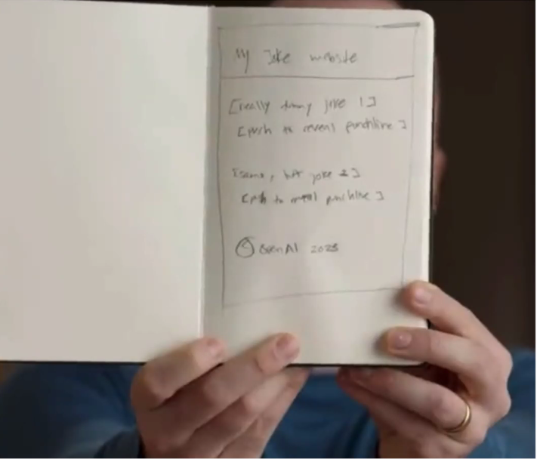
ChatGPT 4
Improvement to existing V3.5
V4 available via paid subscription OR MS Bing
API for developers
Advancements:
Creativity: Collaborating with users on creative projects
Visual input: Receive images as a basis for interaction
Longer context: Process up to 25,000 words
Safety: 40% more factual responses + 82% less likely to “respond to requests for disallowed content.”
Robert Farrell Digital Transformation Institute
Notes:
https://www.digitaltrends.com/computing/chatgpt-4-everything-we-know-so-far/

Slide 23
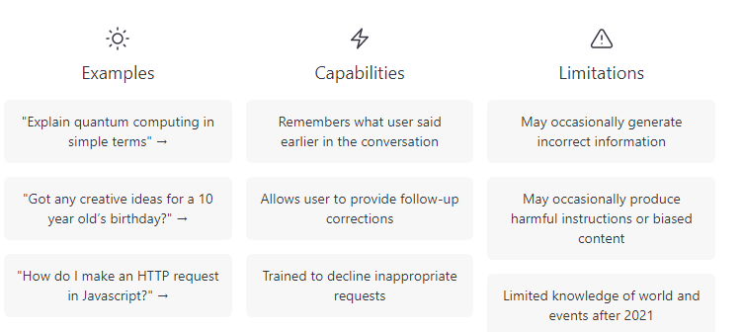
ChatGPT
Robert Farrell Digital Transformation Institute

Slide 24
Other Examples
Robert Farrell

Slide 25
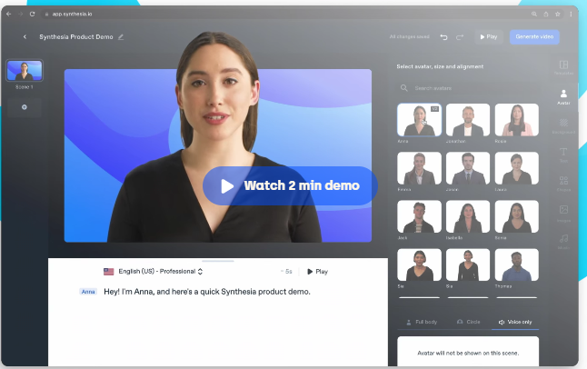
Synthesia
Robert Farrell Digital Transformation Institute
Notes:
https://www.synthesia.io/?
https://share.synthesia.io/9fe94fab-03b1-423c-960e-42fadc4beef6

Slide 26
Slides AI
Robert Farrell Digital Transformation Institute
Notes:
https://www.slidesai.io/

Slide 27
Jasper
Robert Farrell Digital Transformation Institute
Notes:
https://www.jasper.ai/

Slide 28
Name the actor
Robert Farrell Digital Transformation Institute
Notes:
https://www.trymaverick.com/blog-posts/are-deep-fakes-all-evil-when-can-they-be-used-for-good

Slide 29
Deepfakes
Using Maverick.com
Robert Farrell Digital Transformation Institute

Slide 30
Imagery
Robert Farrell

Slide 31
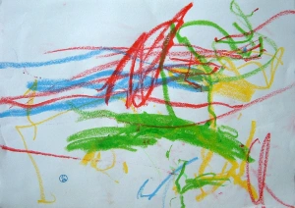
My graphic design skills
Robert Farrell Digital Transformation Institute

Slide 32
DALL-E
Robert Farrell Digital Transformation Institute

Slide 33
Mid Journey
Robert Farrell Digital Transformation Institute

Slide 34
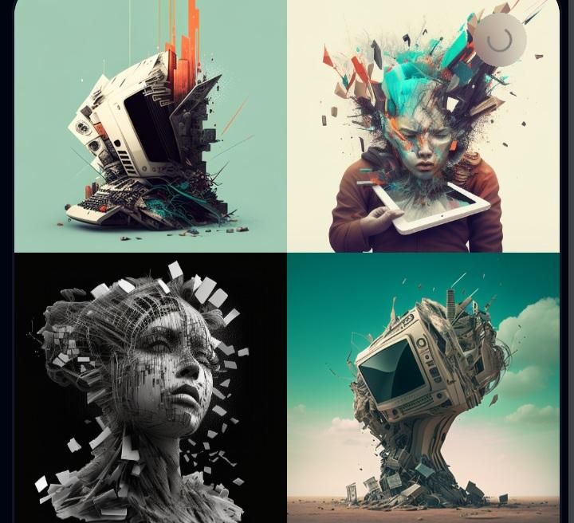
Why use stock images?
Robert Farrell Digital Transformation Institute

Slide 35
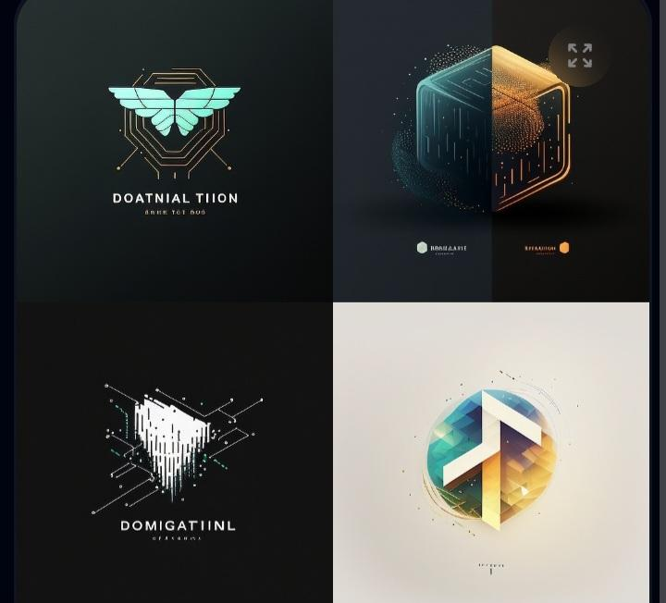
Need a logo?
Robert Farrell Digital Transformation Institute

Slide 36
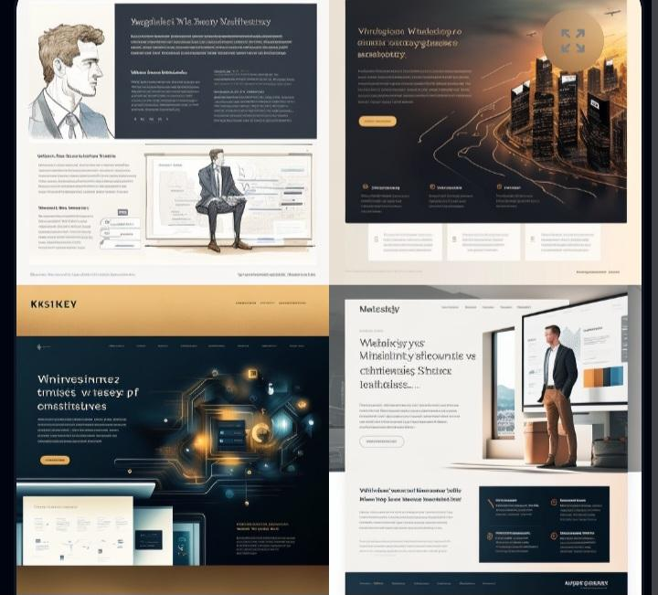
Inspiration for web pages
Robert Farrell Digital Transformation Institute

Slide 37
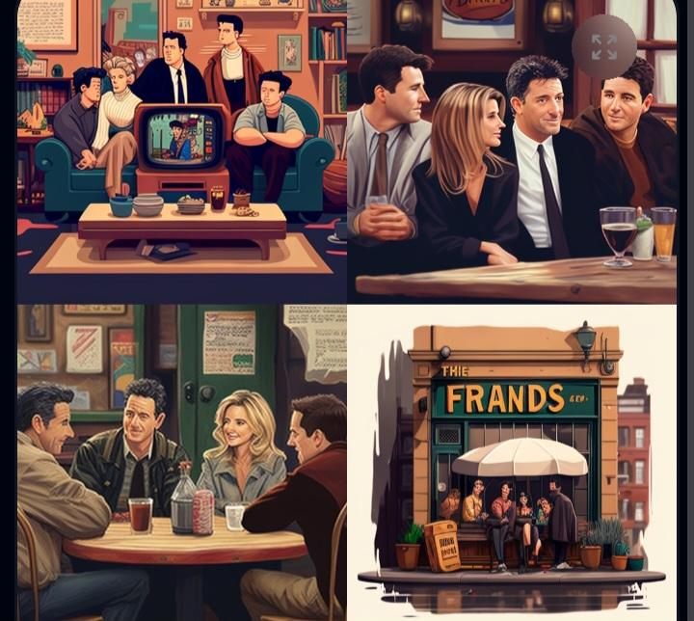
Robert Farrell Digital Transformation Institute

Slide 38
Which one is real?
A B
Robert Farrell Digital Transformation Institute
Notes:
https://www.trymaverick.com/blog-posts/are-deep-fakes-all-evil-when-can-they-be-used-for-good

Slide 39
Is anything real anymore?
Robert Farrell Digital Transformation Institute
Notes:
https://www.trymaverick.com/blog-posts/are-deep-fakes-all-evil-when-can-they-be-used-for-good

Slide 40
Robert Farrell Digital Transformation Institute
Notes:
https://www.trymaverick.com/blog-posts/are-deep-fakes-all-evil-when-can-they-be-used-for-good

Slide 41
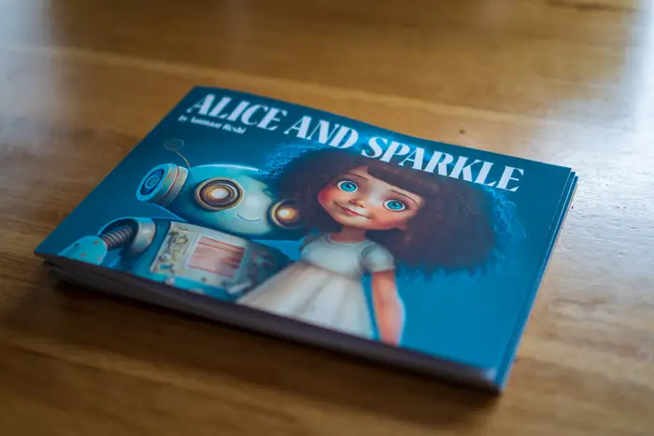
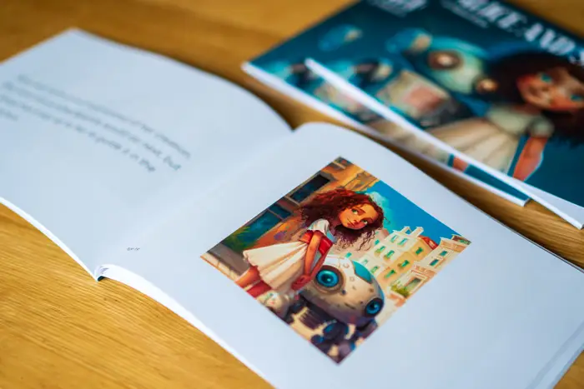
This man used AI to write and illustrate a children's book in one weekend. (Business Insider 15/01/23)
Backlash from writers and illustrators
Robert Farrell Digital Transformation Institute
Notes:
https://www.businessinsider.com/chatgpt-midjourney-ai-write-illustrate-childrens-book-one-weekend-alice-2023-1?r=US&IR=T

Slide 42
Considerations for Boards
Robert Farrell

Slide 43
Limitations of Generative AI (not just ChatGPT)
Quality of generated content
Inaccuracies/errors
Results may vary
Bias based on training data
Improper use by humans
Concerns over ownership, copyright, IP
Deepfakes
Robert Farrell Digital Transformation Institute

Slide 44
Business Benefits of Artificial Intelligence
Customer service & reduced inbound queries via chatbots
Better text websites
Sentiment analysis to assess customer satisfaction
Fraud detection
Efficiency: time savings and automation
Using insights to inform decision-making
(Wharton)
Robert Farrell Digital Transformation Institute
Notes:
https://online.wharton.upenn.edu/blog/how-do-businesses-use-artificial-intelligence/

Slide 45
Tips
Focus on how AI will impact your organization & industry
Identify ways to exploit opportunities & manage challenges
Choices are centered on 3 key pillars:
Robert Farrell Digital Transformation Institute
Notes:
https://www.bcg.com/publications/2023/ceo-guide-to-ai-revolution?

Slide 46
v
v
Robert Farrell Digital Transformation Institute
Notes:
https://www.bcg.com/publications/2023/ceo-guide-to-ai-revolution?

Slide 47
Adapt an Existing AI Model
Snorkel AI found that it cost $1,915 - $7,418 to fine-tune an AI model to complete a complex legal classification
The application could save hours of lawyer’s time $500 ph
Robert Farrell Digital Transformation Institute
Notes:
https://www.bcg.com/publications/2023/ceo-guide-to-ai-revolution?

Slide 48
Key Takeaways
AI is an umbrella term
GenAI creates new media
Opportunities, Challenges, Limits
Consider how AI will impact your org & industry
AI ecosystem is emerging (training, advisory, development)
Future Skill (Using AI, Interpersonal Skills, Critical Thinking, Analysis)
Let’s connect on Linkedin (Robert Farrell)
Robert Farrell Digital Transformation Institute

Slide 49
AI + HI = SUCCESS
Robert Farrell Digital Transformation Institute

Slide 50
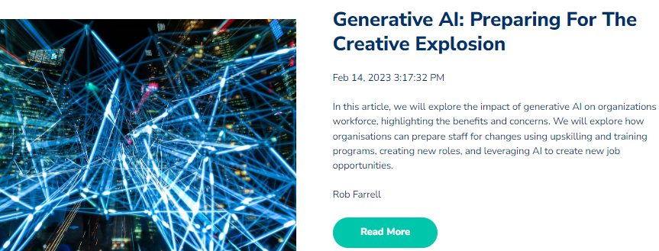
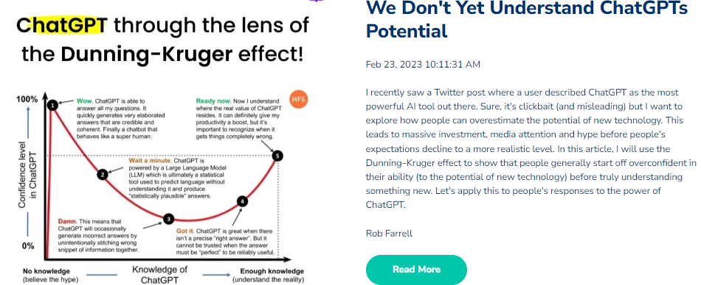
Digital Transformation Institute.ie
Robert Farrell Digital Transformation Institute
Notes:
https://www.digitaltransformationinstitute.ie/

Slide 51
Unleashing
Machine Creativity
Robert Farrell
Digital Transformation Institute
Notes:
If you are worried about the terminator and robots stealing your job then level up your skills by learning to use generative AI to create text, logos, videos, design websites, provide recommendations and even deliver your client presentations… but can it make your coffee?
Understand the concept of generative artificial intelligence (AI).
Explore popular generative AI tools and their use with live demonstrations.
Understand the pros/cons and what organisations need to consider.
Generative Artificial Intelligence (AI) has the power to multiply human creativity but this double edge sword has drawbacks. Explore the pros and cons of Generative AI technology and its impact on various industries.

Slide 52
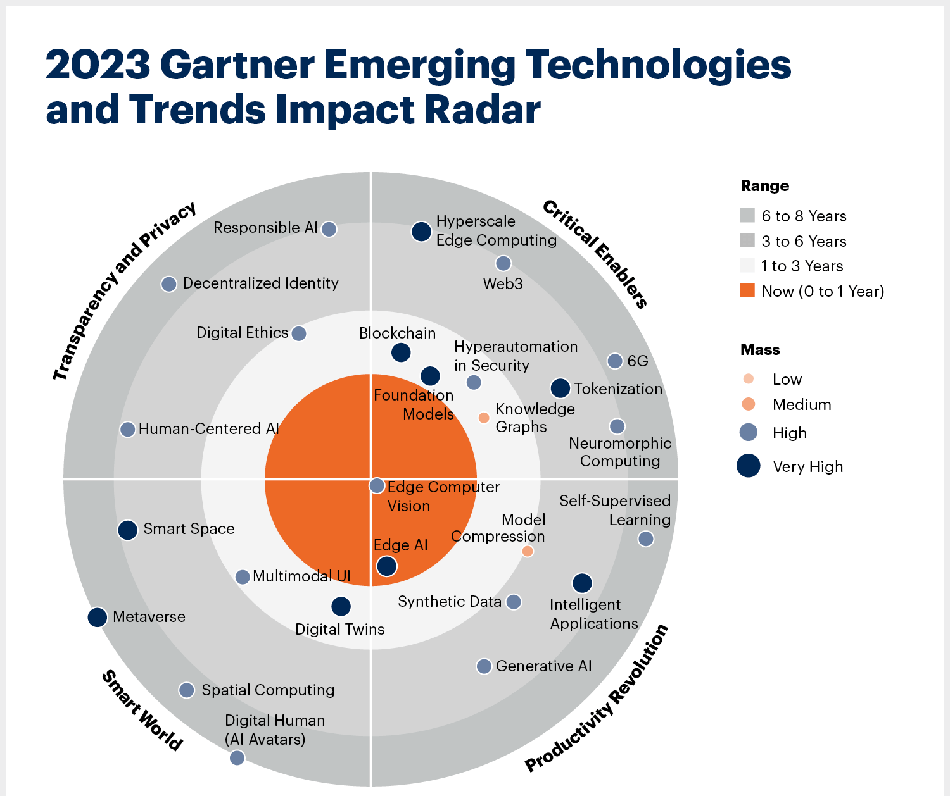
GenAI has only started
Notes:
https://www.gartner.com/en/articles/4-emerging-technologies-you-need-to-know-about?

