Slide 1
Take the saga out of board successions – insights to a winning strategy
James Beasley
Nasdaq Governance Solutions
George Vlachos
Stanton Chase
Lunch & Learn

Slide 2
86% of leaders believe leadership succession planning is of utmost importance; only 14% think their organization does it well. Deloitte, 2014

Slide 3
Only 35% of organizations have a formalized succession planning process. ATD, 2019

Slide 4
70% reported that leadership development programs have been rescheduled or delayed by Covid-19 I4CP, 2020

Slide 5
Key Board Processes
Succession Planning
Board Evaluations & Director Appraisals
Nominations & Appointments
Composition
(‘Skills’) Matrix
Succession Planning
Talent / Diversity Policies & Targets
Board Development / Training

Slide 6
Basics of Succession Planning
Succession Planning
Board level vs. CEO / Executive Succession Planning
Board-level:
Focused on key roles e.g. Chair, Co. Chair
Closely aligned to: Composition Matrix
CEO / Exec. Level:
Natural focus on CEO
Closely aligned to: Talent Management Framework
Frameworks should allow for strategic as well as emergency succession
Key benefit is maintaining control – organisations don’t want these decisions taken out of their hands!

Slide 7
Key Questions
Succession Planning
Why is Succession Planning Important?
What Should Firms / Boards Do?
Where do Firms / Boards Go Wrong?
Why Do Firms / Boards Struggle?

Slide 8
Why is Succession Planning Important?
Succession Planning
Helps the Board to discharge supervision responsibilities
Gives confidence to stakeholders
Motivates management and aligns that motivation with the organization’s strategic aims
Mitigates risk of financial and reputational damage to the organization
Why is Succession Planning Important?

Slide 9
What Should Firms / Boards Do?
Succession Planning
Create a workable framework setting out the approach (incl. scope, processes, timings and metrics)
Align with complementary docs e.g. Role Profiles, grade / role competencies
Develop formal plan(s)
Review and Test vs scenarios and risks
Ensure it is dynamic not static
Allow for 2-3 options (conduct external benchmarking if not possible)
What Should Firms / Boards Do?

Slide 10
Where do Firms / Boards Go Wrong?
Succession Planning
Fail to address holistically (understanding links to other frameworks and processes)
Lack formality or intent e.g. standalone plan or annual board item
Limit the scope to the CEO only, missing the bigger picture (Board, senior management, other critical roles e.g. CISO)
Where do Firms / Boards Go Wrong?

Slide 11
Why Do Firms / Boards Struggle?
Succession Planning
Questions haven’t historically been asked (implicit rather than explicit requirements)
Culture of CEO acting as filter and therefore controlling the process
Not an everyday occurrence: Few have experienced CEO change in practice
Oft-overlooked and less tangible area of talent management
Assumptions re: time available to build potential successors (closing competency gaps)
Defaulting to external search (for prior exp.)
Too much talent; not enough room
Why Do Firms / Boards Struggle?

Slide 12
Questions for boards to ask
Succession Planning
Board Experience
Current Practices
Stakeholders
What experience of succession do we have on the board and how can we harness it?
How formal, dynamic and embedded is our approach at the moment?
How can we communicate our approach to our stakeholder groups?
Risks
Robustness
What risks are there that our succession planning will be tested in the short-medium term?
Is our succession planning process suitably linked to the other board and wider talent / governance processes, and core governance documents?

Slide 13
Sustainability Leadership & interpersonal skills (self & peer-to-peer evaluation)
Demographics and Diversity
Time commitment
Training needs
Individual & Collective Suitability Assessment
Professional skills & experience (self & peer-to-peer evaluation)
Board Succession Planning –
Target Board Profile
Areas of evaluation

Slide 14
Age
Gender
Ethnicity
Culture rich
Independent
Board tenures
Domain and/or functional expertise
Professional experience
Geography expertise
Board Succession Planning - Target Board Profile
Diversity 9- report dimensions

Slide 15
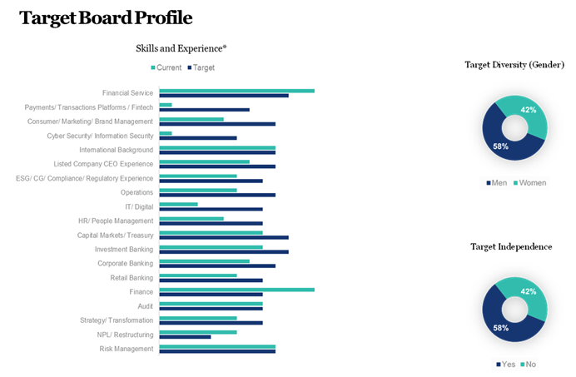
Board Succession Planning - Target Board Profile

